Slide 1
Unit 2
HTML Introduction

Slide 2
What is HTML?
HTML is the standard markup language for creating Web pages.
HTML stands for Hyper Text Markup Language
HTML describes the structure of a Web page
HTML consists of a series of elements
HTML elements tell the browser how to display the content
HTML elements are represented by tags

Slide 3
A Simple HTML Document
Example
<!DOCTYPE html>
<html>
<head>
<title>Page Title</title>
</head>
<body>
<h1>My First Heading</h1>
<p>My first paragraph.</p>
</body>
</html>

Slide 4
The <!DOCTYPE html> declaration defines this document to be HTML5
The <html> element is the root element of an HTML page
The <head> element contains meta information about the document
The <title> element specifies a title for the document
The <body> element contains the visible page content
The <h1> element defines a large heading
The <p> element defines a paragraph

Slide 5
HTML Tags
HTML tags
element names surrounded by angle brackets:
<tagname>content goes here...</tagname>
HTML tags normally come in pairs like <p> and </p>
The first tag in a pair is the start tag, the second tag is the end tag
The end tag is written like the start tag, but with a forward slash inserted before the tag name
HTML Headings
HTML headings are defined with the <h1> to <h6> tags.
<h1> defines the most important heading.
<h6> defines the least important heading:

Slide 6
HTML Block and Inline Elements
Block-level Elements :
A block-level element always starts on a new line and takes up the full width available (stretches out to the left and right as far as it can).
The <div> element is a block-level element.
Example
<div>Hello World</div>

Slide 7
Inline Elements
An inline element does not start on a new line and only takes up as much width as necessary.
This is an inline <span> element inside a paragraph.

Slide 8
Example <span>Hello World</span>
The <span> Element
The <span> element is often used as a container for some text.
The <span> element has no required attributes, but style, class and id are common.
When used together with CSS, the <span> element can be used to style parts of the text:
Example
<h1>My <span style="color:red">Important</span> Heading</h1>

Slide 9
HTML Text Formatting Elements
<b> Defines bold text
<em> Defines emphasized text
<i> Defines italic text
<small> Defines smaller text
<strong> Defines important text
<sub> Defines subscripted text
<sup> Defines superscripted text
<ins> Defines inserted text
<del> Defines deleted text
<mark> Defines marked/highlighted text

Slide 10
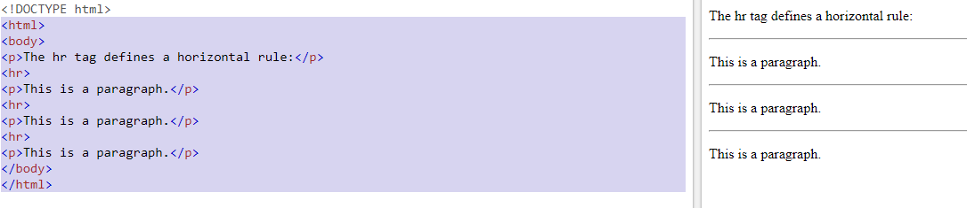
<hr> tag

Slide 11
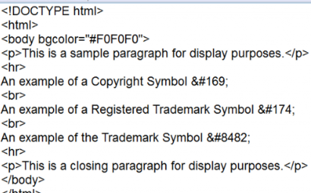
Special Characters in HTML

Slide 12
HTML comments
This element is used to add a comment to an HTML document.
An HTML comment begins with <!–– and the comment closes with ––>.
HTML comments are visible to anyone that views the page source code, but are not rendered when the HTML document is rendered by a browser.

Slide 13
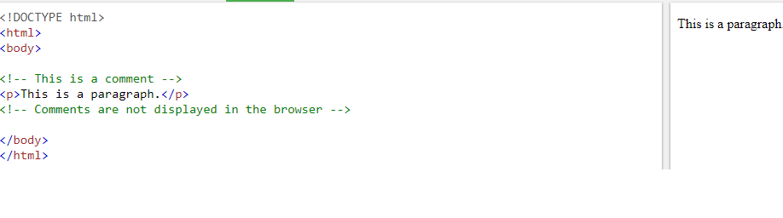

Slide 14
Meta tag in html
Metadata is data (information) about data.
The <meta> tag provides metadata about the HTML document.
Metadata will not be displayed on the page
Meta elements are typically used to specify page description, keywords, author of the document, last modified, and other metadata.
The metadata can be used by browsers (how to display content or reload page), search engines (keywords), or other web services.

Slide 15
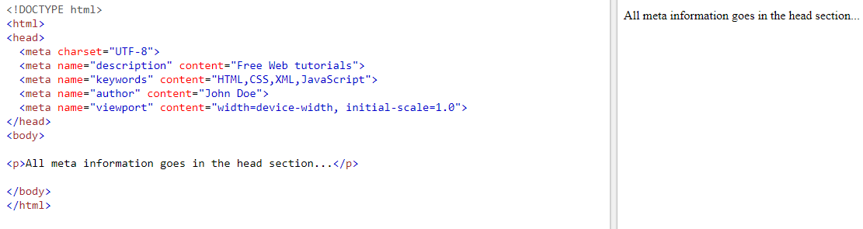

Slide 16
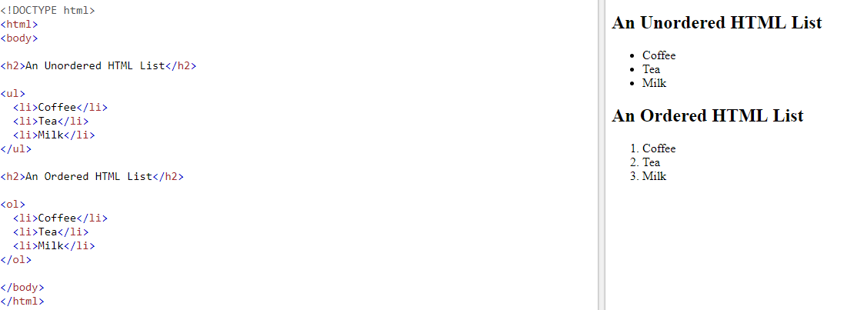
Lists in HTML

Slide 17
Definition List <dl> tag
The <dl> tag defines a description list.
The <dl> tag is used in conjunction with <dt> (defines terms/names) and <dd> (describes each term/name).

Slide 18
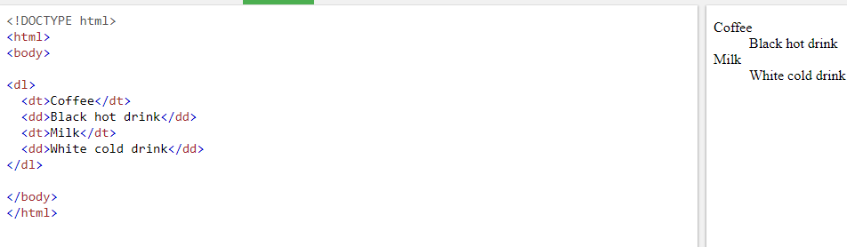

Slide 19
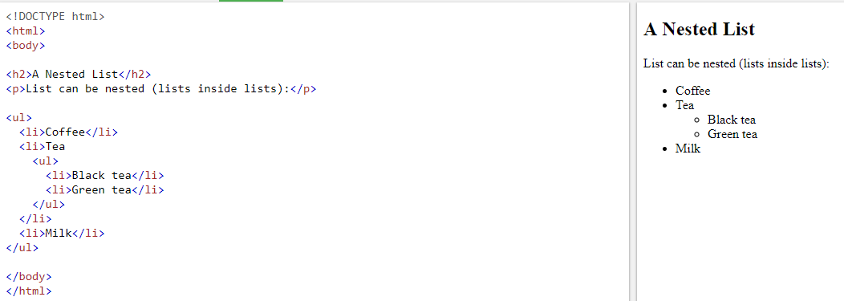

Slide 20
HTML Links - Hyperlinks
HTML links are hyperlinks.
we can click on a link and jump to another document.
When we move the mouse over a link, the mouse arrow will turn into a little hand.

Slide 21
HTML Links - Syntax
Hyperlinks are defined with the HTML <a> tag:
<a href="url">link text</a>

Slide 22
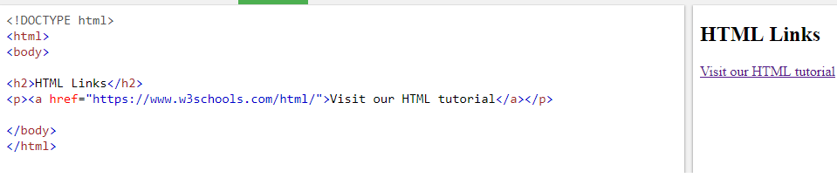
The href attribute specifies the destination address (https://www.w3schools.com/html/) of the link.
The link text is the visible part (Visit our HTML tutorial).
Clicking on the link text will send you to the specified address.

Slide 23
What are Absolute URLs?
Absolute URL requires you to place the entire address on the page that you link to.
An example of an absolute URL would look like this:
<a href = http://www.example.com/xyz.html>

Slide 24
What are Relative URLs?
The relative URL, on the other hand, does not use the full address.
It assumes that the page you type in is on the same site.
An example of a relative URL would look like this:
<a href = "/xyz.html">

Slide 25
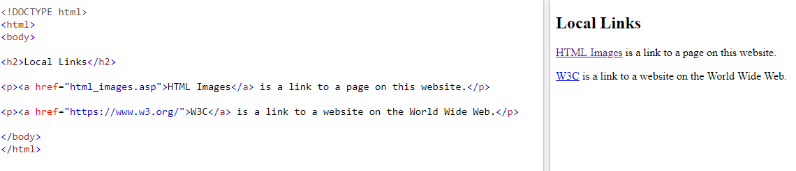

Slide 26
Target Attribute
The target attribute specifies where to open the linked document:
<a href="https://www.w3schools.com" target="_blank">Visit W3Schools</a>

Slide 27
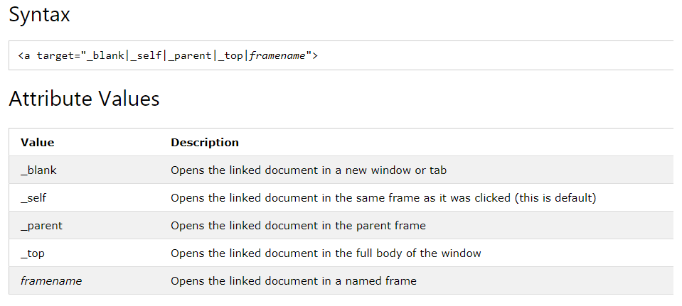

Slide 28
Anchor tag: , Linking To document in folders
Within the same folder, just use the file name:
<a href="thefile.html">my link</a>
Within the parent folder's directory:
<a href="../thefile.html">my link</a>
Within a sub-directory:
<a href="subdir/thefile.html">my link</a>

Slide 29
Anchor Element in HTML
The anchor element is used to create hyperlinks between a source anchor and a destination anchor.
The source is the text, image, or button that links to another resource
The destination is the resource that the source anchor links to.

Slide 30
The Anchor Element
The anchor element tag is the letter “a” surrounded by angle brackets like this: <a>.
Both the opening and closing attributes are required, and all of the content between the tags makes up the anchor source.

Slide 31
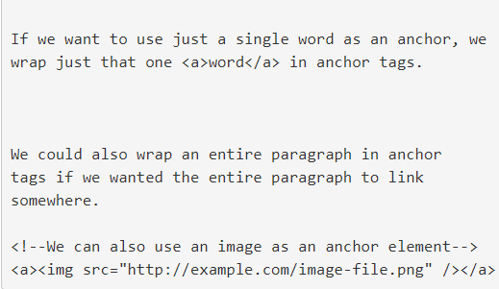

Slide 32
Anchor tag to specific section within the document
HTML bookmarks are used to allow readers to jump to specific parts of a Web page.
Bookmarks can be useful if your webpage is very long.
To make a bookmark, you must first create the bookmark, and then add a link to it.
When the link is clicked, the page will scroll to the location with the bookmark.

Slide 33
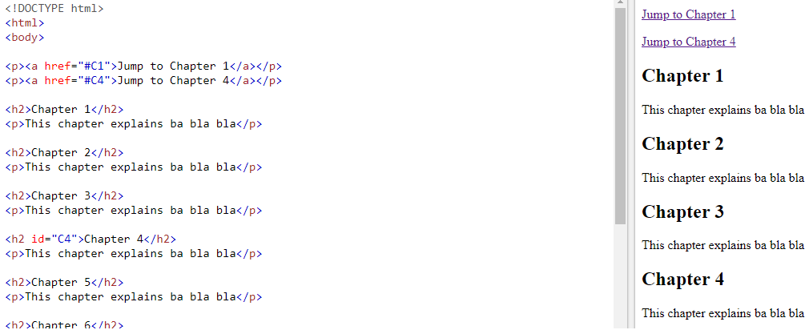
Demo for bookmark

